Slide 1
Software Engineering Principles

Slide 2
Outline
Principles form the basis of methods, techniques, methodologies and tools
Seven important principles that may be used in all phases of software development
Modularity is the cornerstone principle supporting software design

Slide 3
Application of principles
Principles apply to process and product
Principles become practice through methods and techniques
  often methods and techniques are packaged in a methodology
  methodologies can be enforced by tools

Slide 4
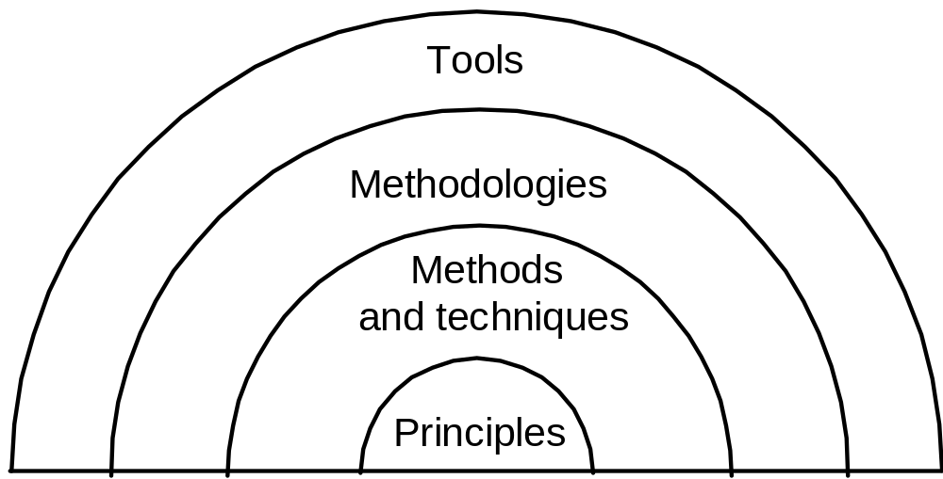
A visual representation

Slide 5
Key principles
Rigor and formality
Separation of concerns
Modularity
Abstraction
Anticipation of change
Generality
Incrementality

Slide 6
Rigor and formality
Software engineering is a creative design activity, BUT
It must be practiced systematically
Rigor is a necessary complement to creativity that increases our confidence in our developments
Formality is rigor at the highest degree
  software process driven and evaluated by mathematical laws

Slide 7
Examples: product
Mathematical (formal) analysis of program correctness
Systematic (rigorous) test data derivation

Slide 8
Example: process
Rigorous documentation of development steps helps project management and assessment of timeliness

Slide 9
Separation of concerns
To dominate complexity, separate the issues to concentrate on one at a time
"Divide & conquer"
Supports parallelization of efforts and separation of responsibilities

Slide 10
Example: process
Go through phases one after the other (as in waterfall)
  Does separation of concerns by separating activities with respect to time

Slide 11
Example: product
Keep product requirements separate
  functionality
  performance
  user interface and usability

Slide 12
Modularity
A complex system may be divided into simpler pieces called modules
A system that is composed of modules is called modular
Supports application of separation of concerns
  when dealing with a module we can ignore details of other modules

Slide 13
Cohesion and coupling
Each module should be highly cohesive
  module understandable as a meaningful unit
  Components of a module are closely related to one another
Modules should exhibit low coupling
  modules have low interactions with others
  understandable separately

Slide 14
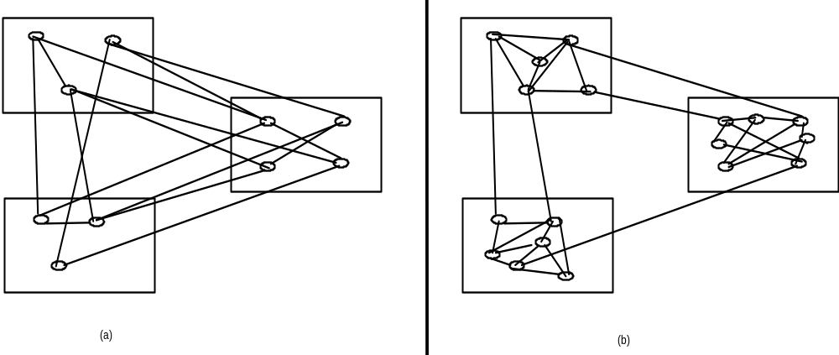
A visual representation
high coupling
low coupling

Slide 15
Abstraction
Identify the important aspects of a phenomenon and ignore its details
Special case of separation of concerns
The type of abstraction to apply depends on purpose
Example : the user interface of a watch (its buttons) abstracts from the watch's internals for the purpose of setting time; other abstractions needed to support repair

Slide 16
Abstraction ignores details
Example: equations describing complex circuit (e.g., amplifier) allows designer to reason about signal amplification
Equations may approximate description, ignoring details that yield negligible effects (e.g., connectors assumed to be ideal)

Slide 17
Abstraction yields models
For example, when requirements are analyzed we produce a model of the proposed application
The model can be a formal or semiformal description
It is then possible to reason about the system by reasoning about the model

Slide 18
An example
Programming language semantics described through an abstract machine that ignores details of the real machines used for implementation
  abstraction ignores details such as precision of number representation or addressing mechanisms

Slide 19
Abstraction in process
When we do cost estimation we only take some key factors into account
We apply similarity with previous systems, ignoring detail differences

Slide 20
Anticipation of change
Ability to support software evolution requires anticipating potential future changes
It is the basis for software evolvability
Example: set up a configuration management environment for the project

Slide 21
Generality
While solving a problem, try to discover if it is an instance of a more general problem whose solution can be reused in other cases
Carefully balance generality against performance and cost
Sometimes a general problem is easier to solve than a special case

Slide 22
Incrementality
Process proceeds in a stepwise fashion (increments)
Examples (process)
  deliver subsets of a system early to get early feedback from expected users, then add new features incrementally
  deal first with functionality, then turn to performance
  deliver a first prototype and then incrementally add effort to turn prototype into product

Slide 23
Case study (system engineering): elevator system
In many cases, the "software engineering" phase starts after understanding and analyzing the "systems engineering” issues
The elevator case study illustrates the point

Slide 24
Rigor&formality (1)
Quite relevant: it is a safety critical system
  Define requirements
    must be able to carry up to 400 Kg. (safety alarm and no operation if overloaded)
    emergency brakes must be able to stop elevator within 1 m. and 2 sec. in case of cable failures
  Later, verify their fulfillment

Slide 25
Separation of concerns
Try to separate
  safety
  performance
  usability (e.g, button illumination)
  cost
although some are strongly related
  cost reduction by using cheap material can make solution unsafe

Slide 26
A modular structure
Control
apparatus
buttons at floor i
B3
Elevator
B2
B1

Slide 27
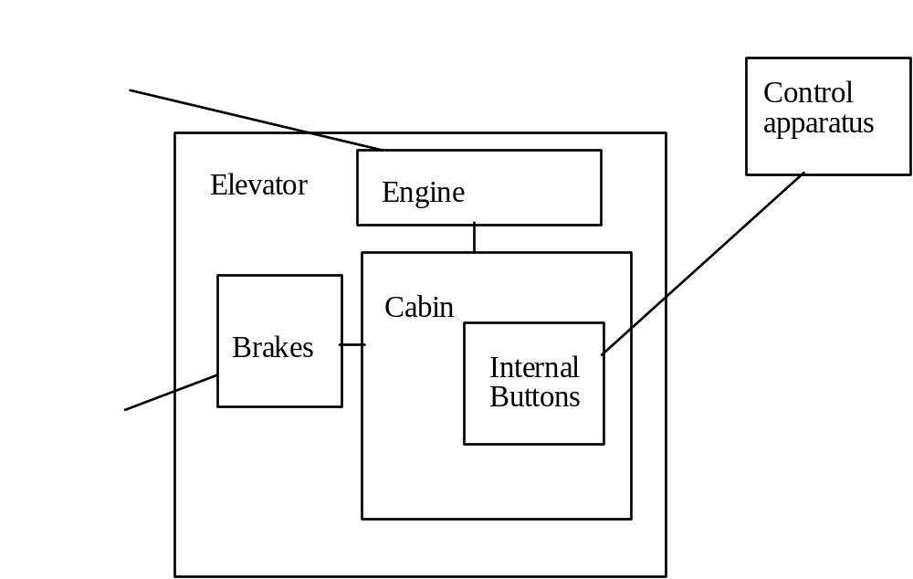
Module decomposition may be iterated

Slide 28
Abstraction
The modular view we provided does not specify the behavior of the mechanical and electrical components
  they are abstracted away
  https://www.d.umn.edu/~gshute/softeng/principles.html

Slide 29
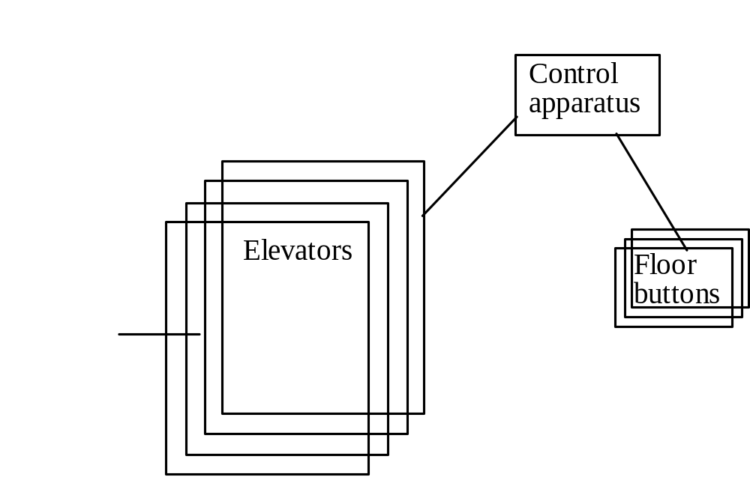
Anticipation of change, generality
Make the project parametric wrt the number of elevators (and floor buttons)

Slide 30
Case study: compiler
Compiler construction is an area where systematic (formal) design methods have been developed
  e.g., BNF for formal description of language syntax

Slide 31
Separation of concerns example
When designing optimal register allocation algorithms (runtime efficiency) no need to worry about runtime diagnostic messages (user friendliness)

Slide 32
Modularity
Compilation process decomposed into phases
  Lexical analysis
  Syntax analysis (parsing)
  Code generation
Phases can be associated with modules

Slide 33
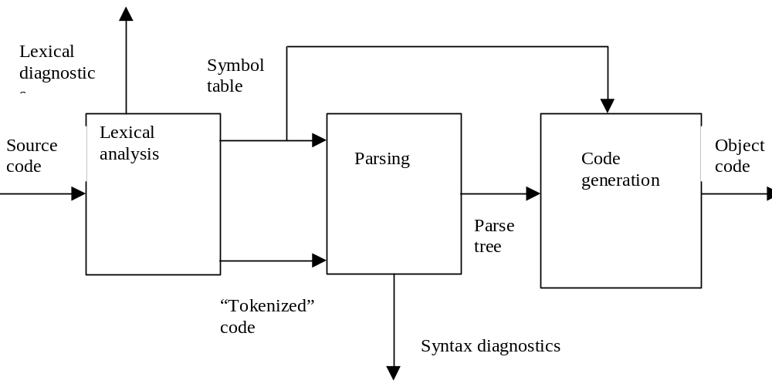
Representation of modular structure
boxes represent modules
directed lines represent interfaces

Slide 34
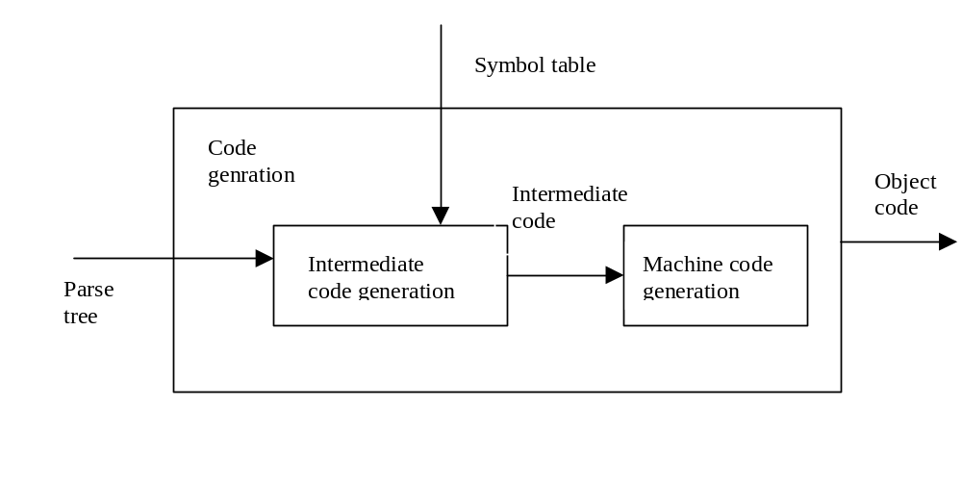
Module decomposition may be iterated
further modularization of code-generation module

Slide 35
Abstraction
Applied in many cases
  abstract syntax to neglect syntactic details such as begin…end vs. {…} to bracket statement sequences
  intermediate machine code (e.g., Java Bytecode) for code portability

Slide 36
Anticipation of change
Consider possible changes of
  source language (due to standardization committees)
  target processor
  I/O devices

Slide 37
Generality
Parameterize with respect to target machine (by defining intermediate code)
Develop compiler generating tools (compiler compilers) instead of just one compiler

Slide 38
Incrementality
Incremental development
  deliver first a kernel version for a subset of the source language, then increasingly larger subsets
  deliver compiler with little or no diagnostics/optimizations, then add diagnostics/optimizations

